Slide 1
Northwest hunt
Group_5 full stack app

Slide 2


TEAM MEMBERS
Rohith Reddy Avisakula Nooka Raju Boddu
S538294@nwmissouri.edu S538098@nwmissouri.edu

Slide 3
Overview
A location-based gaming application that assists the user in finding the treasure.
It first compares the device's coordinates to the target position and informs the user whether he or she is inside or outside of it.
When the user clicks/touches the first color, it displays a correct treasure location and also a confirmation message stating that a specific location has been chosen will appear.
Even after confirmation, the user is given the option to choose a different spot, and if so, the game can be restarted from the beginning.
Whether the user is inside the treasure location and selects or touches the second color, the user will hear information that a treasure has been won; if the user is outside the target location, the user will hear information about help in finding a treasure like direction to walk, how far away from it, or any other clue.

Slide 4
Stack
Web Framework : Express
Platform: Node(Version - v15.1.0)
View engine : EJS
ORM(Object Relational Mapping) : Sequelize
Data store: PostgreSQL
API : Google Maps
Coding standards : Enforce AirBnB/Prettier/ESlint

Slide 5
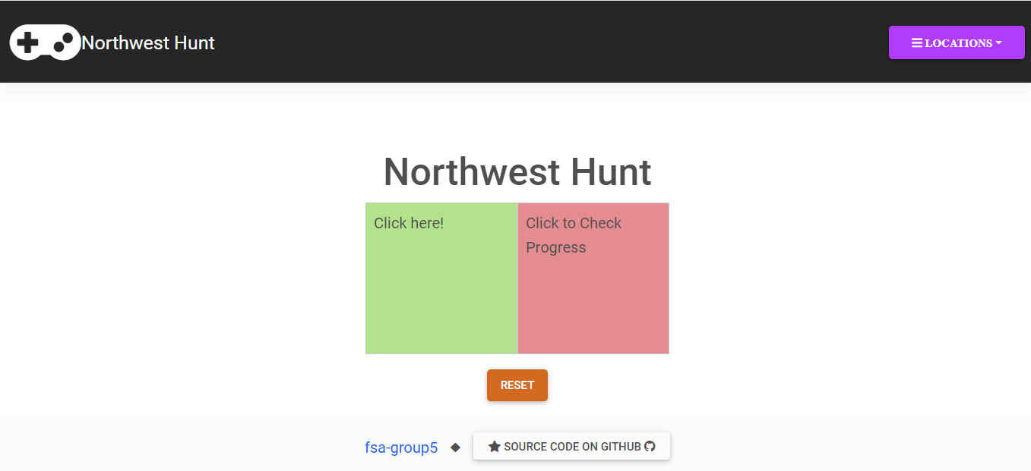
Hosted app https://grp5-full-stack-app.herokuapp.com/
Home page of Northwest Hunt App

Slide 6
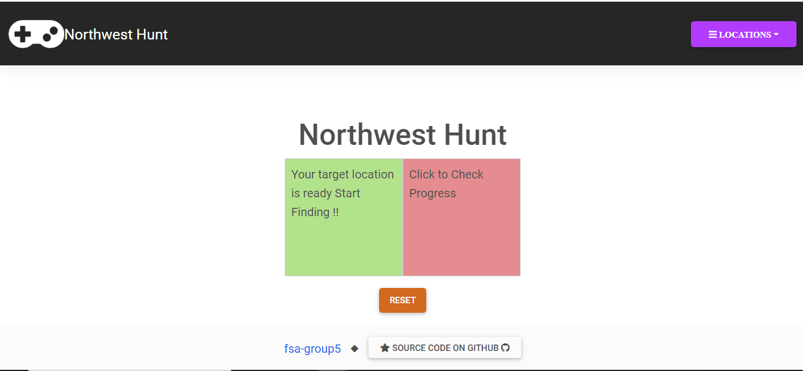
When the user clicks on the first color component a random location is selected.

Slide 7
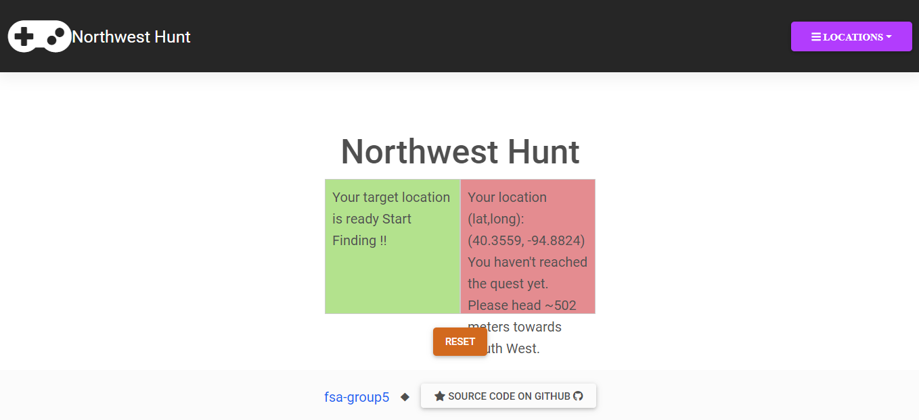
When the user clicks on the second color component, it provides the user with clues like the direction to walk, distance from the treasure etc.

Slide 8
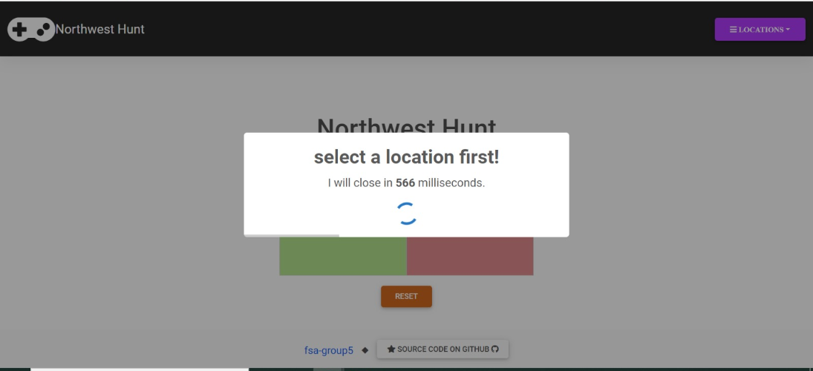
When the user clicks only on the second color component, a timed pop-up notification will appear as shown in the below picture.

Slide 9
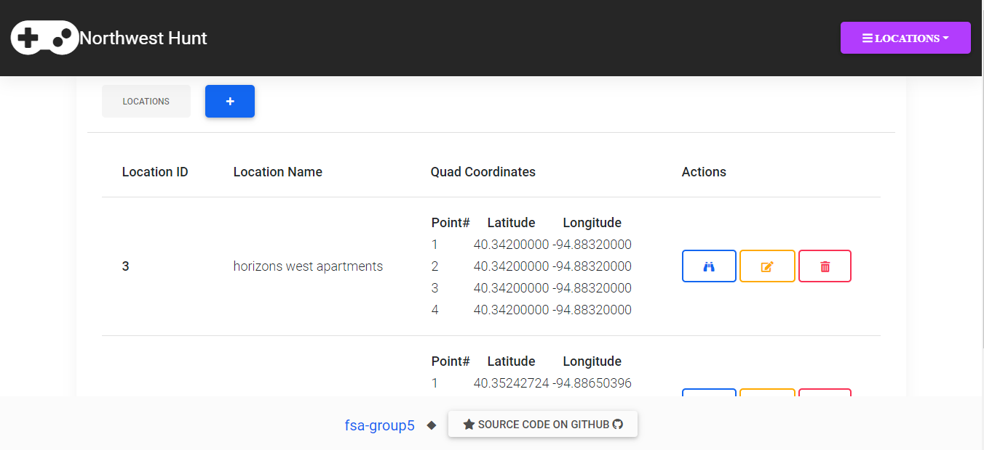
User can create a new location, edit a location, read, and delete the location, can perform all the CRUD operations.

Slide 10
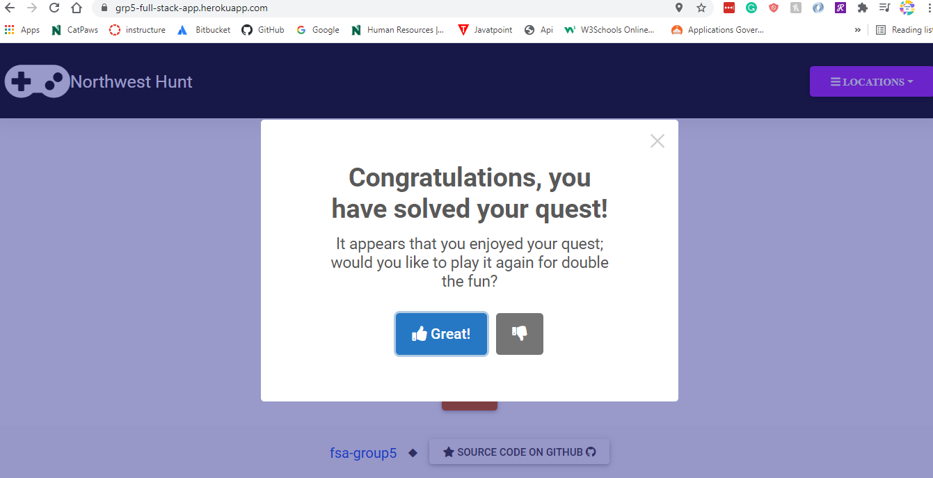
When the user is inside the quest location, a notification will appear on the screen showing that they have reached the location and will be given two options to start the game from the beginning or close the notification.

Slide 11
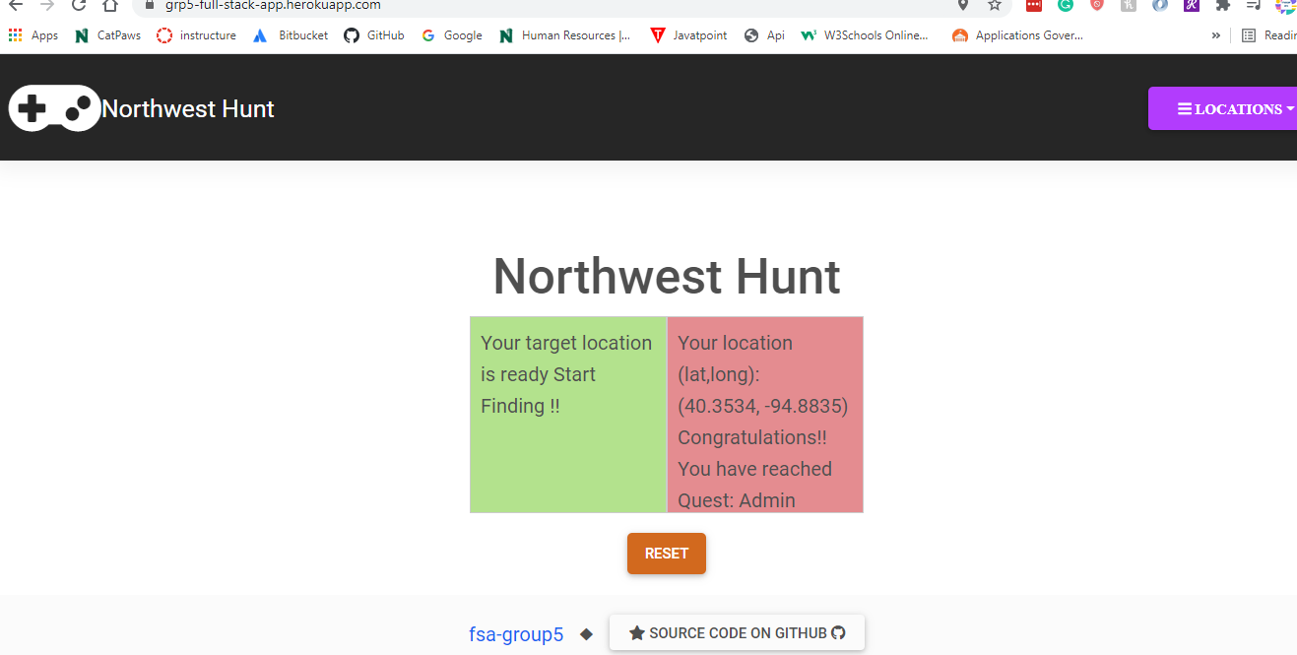
After the pop up shows, the right box will show the location coordinates and name. Reset button is available to start the game

Slide 12


